Slide 1
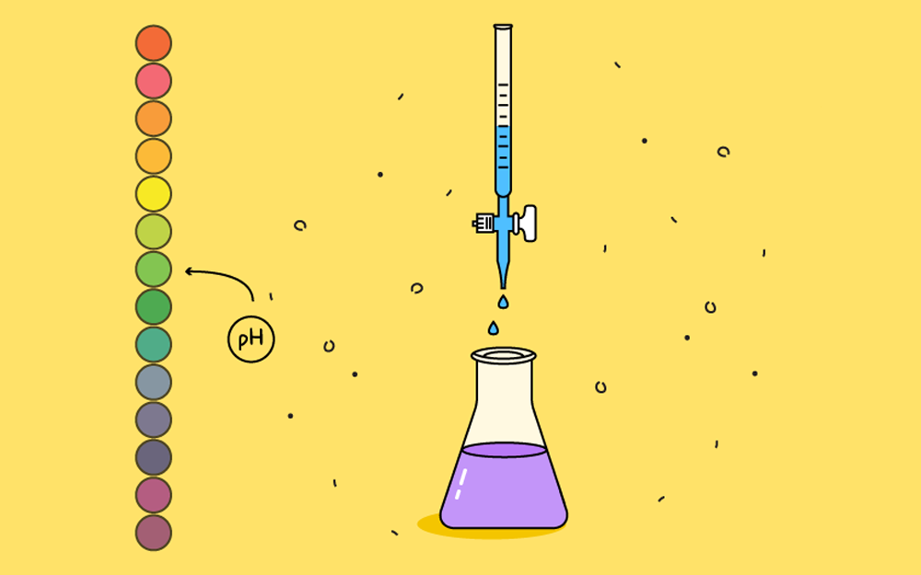
Acids and Bases
ATAR Chemistry Unit 3 2021

Slide 2
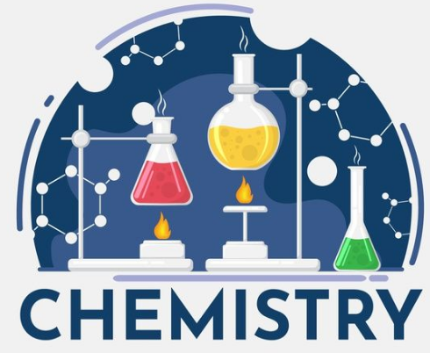
Outline
History of acid-base theory
Review of Arrhenius theory
Introduction of the Bronsted-Lowry theory
Conjugate acid-base pairs

Slide 3
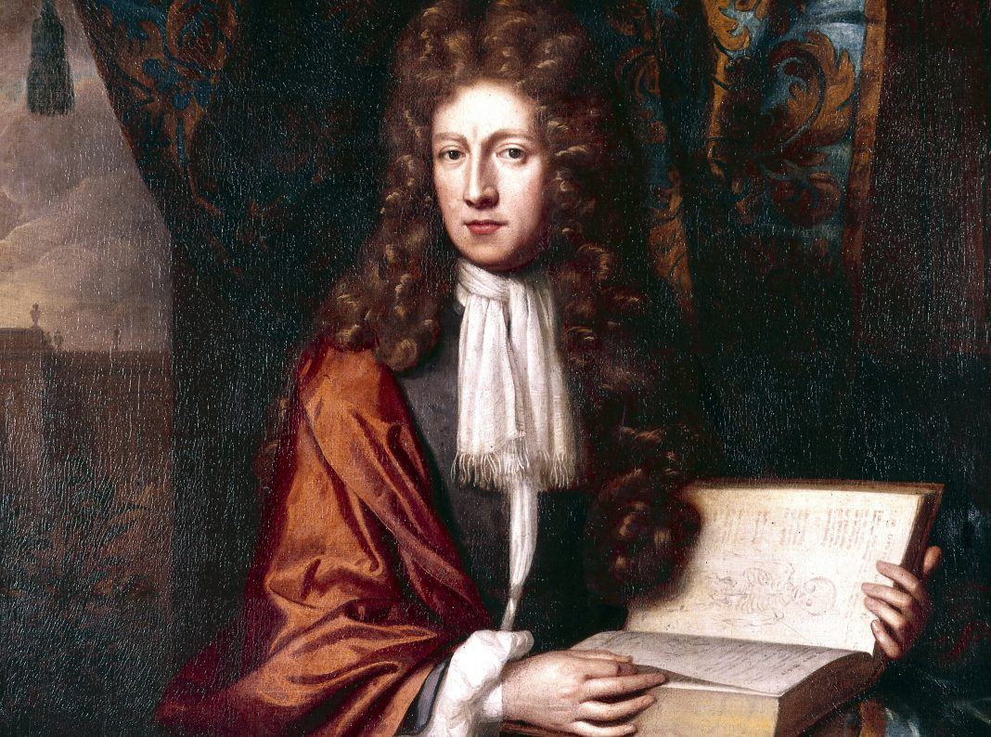
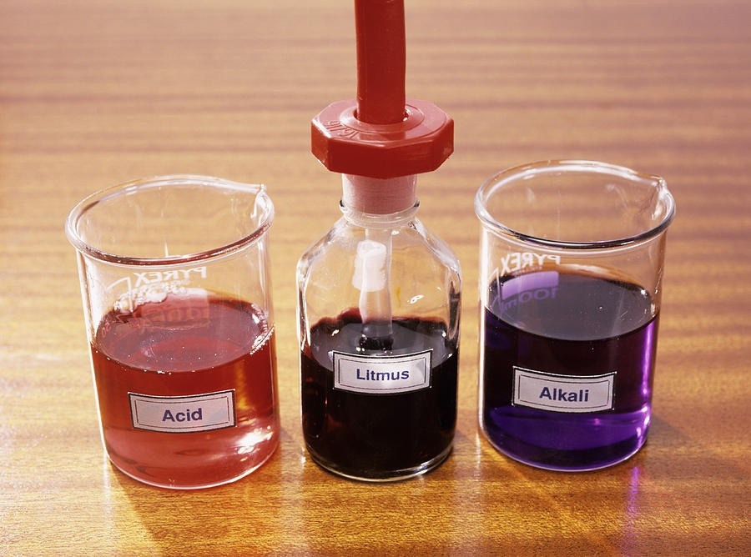
History of acid-base theory
Robert Boyle (1627-1691) came up with the characterisations of acids that we know today. He notices that acids lose their acidity when reacted with bases.
He also developed the litmus test for identifying acids and bases.
He did not have a theory that could explain the observations.

Slide 4
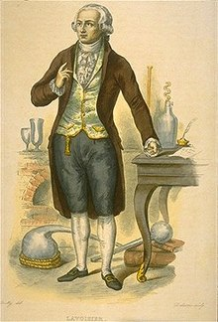
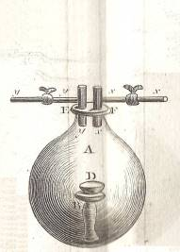
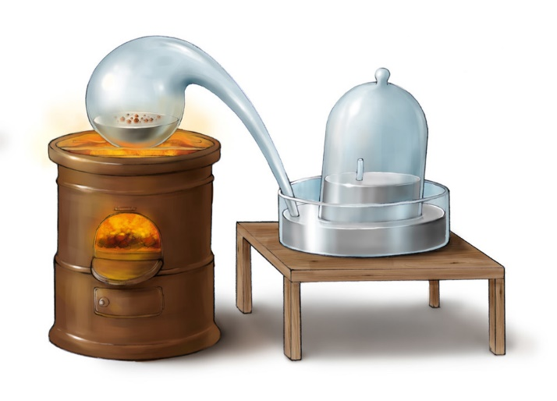
History of acid-base theory
Antoine Lavoisier (1734-1794) extensive work on combustion (burning in oxygen) and observed that non metal oxides dissolved in water to produced an acidic solutions.
Proposed that the acidity of a compound was due to the presence of oxygen.

Slide 5
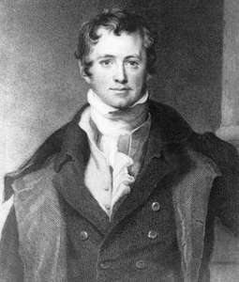
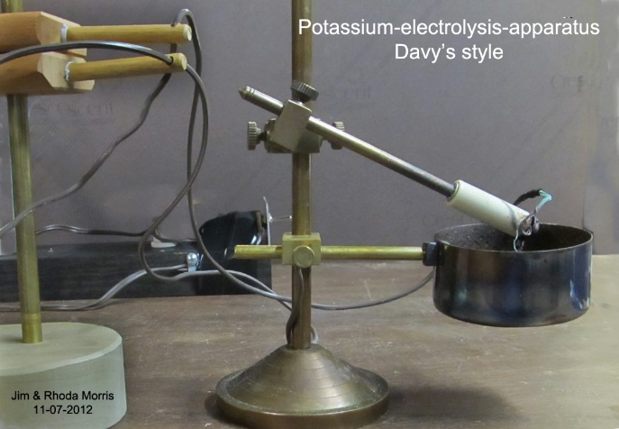
History of acid-base theory
Humphrey Davy (1778-1829) using Volta’s chemical cell and the process of electrolysis separated many metals from their molten compounds.
Through experimental observations concluded that group 1 and 2 metal oxides formed strongly basic compounds 1807-1808. This contradicted Lavoisier’s Theory.
Also discovered muriatic acid (hydrochloric acid) did not contain any oxygen, this led Davy to propose the presence of hydrogen in a compound gave it acidic characteristics.

Slide 6
History of acid-base theory
Humphrey Davy (1778-1829) using Volta’s chemical cell and the process of electrolysis separated many metals from their molten compounds.
Through experimental observations concluded that group 1 and 2 metal oxides formed strongly basic compounds 1807-1808. This contradicted Lavoisier’s Theory.
Also discovered muriatic acid (hydrochloric acid) did not contain any oxygen, this led Davy to propose the presence of hydrogen in a compound gave it acidic characteristics.

Slide 7
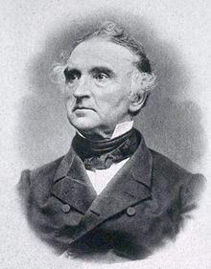
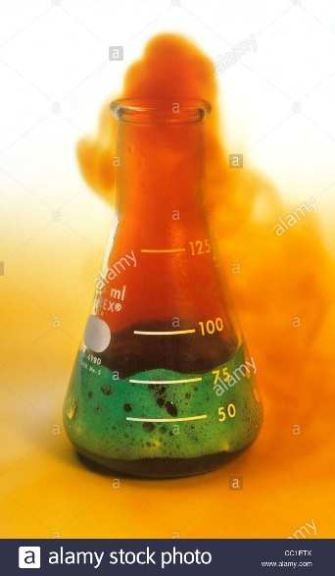
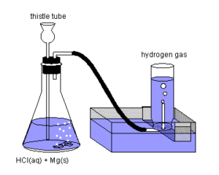
History of acid-base theory
Davy’s theory could not account for substances that contained hydrogen but not acidic, such as methane (CH₄).
Von Liebig (1803-1873) observed that acids could produce hydrogen gas with metals and proposed a modification to Davy’s Theory.
He described acids with replaceable hydrogen.
Problems still existed, such as Copper and nitric acid produces nitrogen dioxide gas instead of hydrogen gas.

Slide 8
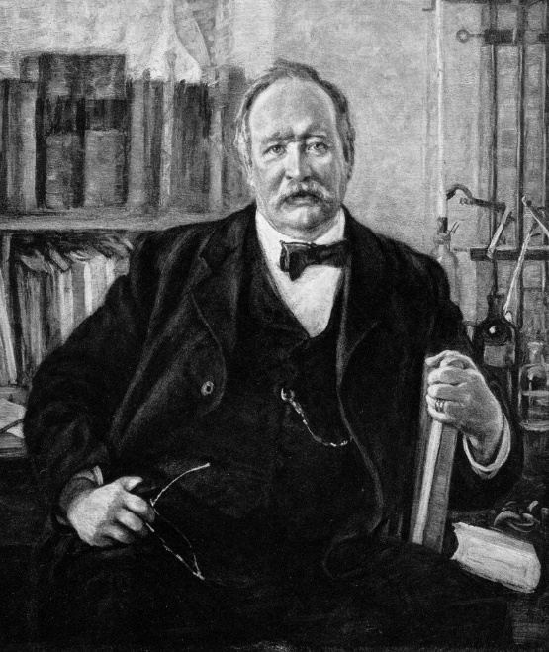
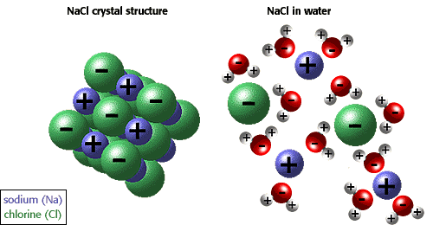
History of acid-base theory
Svante Arrhenius (1859-1927) developed a ground-breaking theory on electrolytic dissociation that described the ions produced in solutions when substances dissolve. (Nobel Prize)
He extended his theory to describe acids and bases as substances that formed hydrogen ions and hydroxide ions in solution.

Slide 9
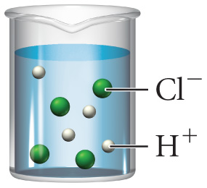
Arrhenius theory
Arrhenius Theory of Acids
HCl_{(g)} → H⁺_{(aq)} + Cl⁻_{(aq)}
Acids ionize in water to produce H⁺ ions
Indicate the solvent is present(aq),
but don’t show it as part of the reaction.

Slide 10
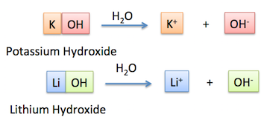
Arrhenius theory
Arrhenius Theory of Bases
Bases dissociates in water to produce OH⁻ ions

Slide 11
Arrhenius theory
The Arrhenius Theory could also account for the strength of Acids based on the extent of the Ionisation reaction (reversible).
Strong acids – ionize (break into cations and anions) almost completely
Weak acids – are not fully ionised
HCl_{(g)} → H⁺_{(aq)} + Cl⁻_{(aq)}
CH₃COOH_{(aq)} CH₃COO⁻_{(aq)} + H⁺_{(aq)}
0 %
100 %
99 %
1 %

Slide 12
Arrhenius theory
Problems with Arrhenius Theory of Acids
NH₃ and CO₃⁻ produce OH⁻ ions in solution, but they don’t contain OH in their formula
It only applies to substance in water, but acids and bases exist in other solvents too
Reactions between HCl (aq) and NH₃ (g) can’t be explained (forming NH₄Cl).
Many salts behave as acids or bases
H⁺ does not exist for long in water! It reacts with water to form H₃O⁺ ions.

Slide 13
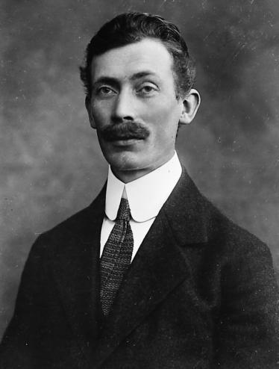
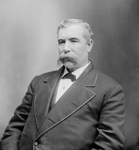
Bronsted-Lowry theory
Danish Johannes Bronsted (1879-1947) and English Thomas Lowry (1874 – 1936) independently proposed a more detailed model of acids and bases involving proton transfer.
This theory can account for the limitations of Arrhenius theory but is still restricted to aqueous solutions.

Slide 14
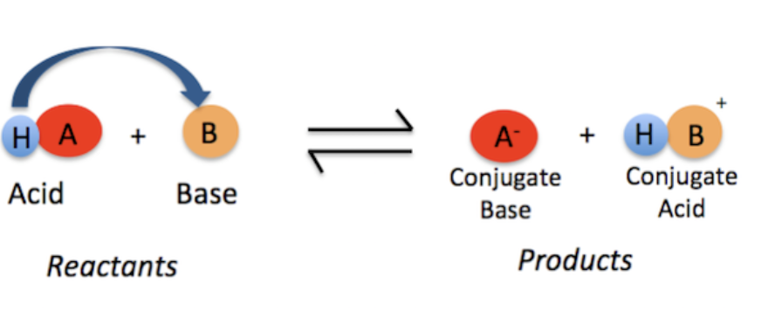
Bronsted-Lowry theory
Acids and bases are defined by an acid-base reaction.
An acid-base reaction is one that involves the transfer of a hydrogen ion, H⁺, from one reactant to another.
The reactant that loses the H⁺ is called the acid and the reactant that gains the H⁺ is the base.

Slide 15
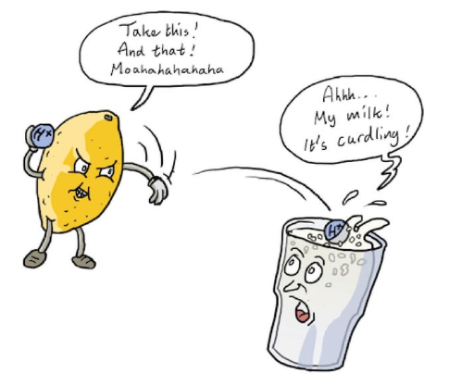
Bronsted-Lowry theory
An easier definition is:
Acid is a Proton Donor
Base is Proton Acceptor

Slide 16
Bronsted-Lowry theory
+
H
CH₃COOH
+
HOH
H
O
H
+
CH₃COO⁻
acid
base
c acid
c base
The protonated base acts as an acid, in the reverse reaction with the deprotonated acid.

Slide 17
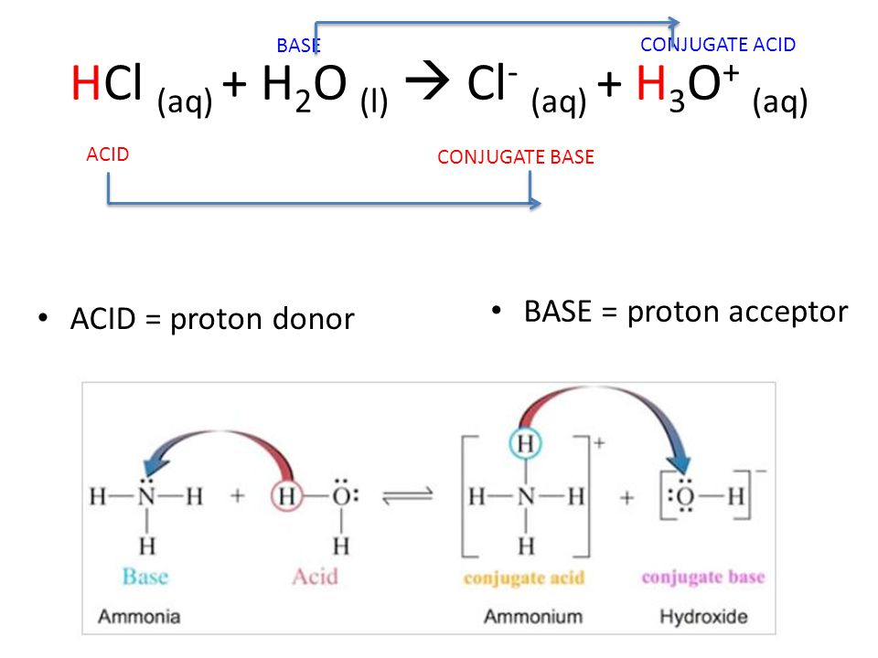
Bronsted-Lowry theory
An acid is a substance that donates a proton (H⁺).
A base is a substance that accepts a proton.
Water can act as both an acid and a base.
Reactions show the proton transfer between the acid and the base.

Slide 18
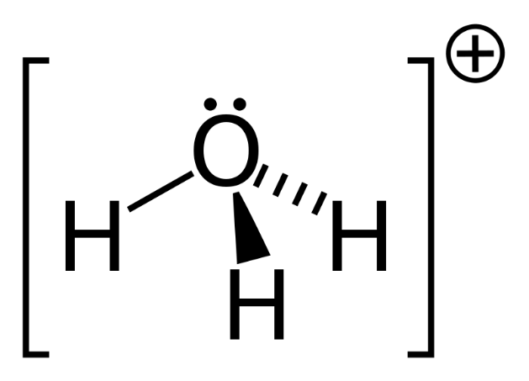
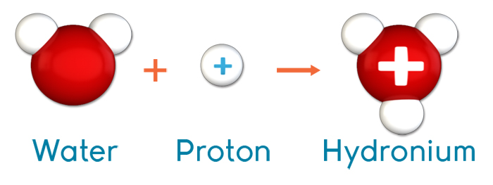
Hydronium
The Hydrogen ion (H+) is known as a proton and is just the nucleus of a hydrogen atom (no electrons). It has a very large charge density and is very attracted to the lone pair of electrons in the water molecule. It joins together forming the Hydronium Ion (H₃O⁺) which is a better representation of what happens in solution.
It is equally acceptable to represent the proton in solution as H⁺ or H₃O⁺ , however, it is more useful as H⁺ for calculations and H₃O⁺ for Bronsted-Lowry acids.

Slide 19
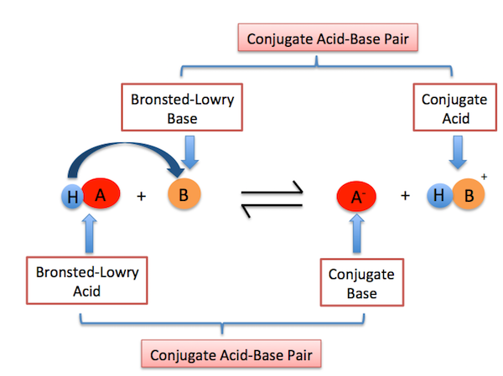
Conjugate acids-bases
When an acid donates a proton a conjugate base is formed. Conversely a conjugate acid is formed when a base accepts a proton. Conjugate means “Joined together”.
Every Bronsted-Lowry acid has a conjugate base, and every Bronsted-Lowry Base has a conjugate acid. They can be identified on either side of the chemical reaction.

Slide 20
Conjugate acids-bases
A. Write the conjugate base of the following.
1. HBr
2. H₂S
3. H₂CO₃
B. Write the conjugate acid of the following.
1. NO₂⁻
2. NH₃
3. OH⁻

Slide 21
Conjugate acids-bases
Solutions
A. Remove H⁺ to write the conjugate base.
1. HBr Br⁻
2. H₂S HS⁻
3. H₂CO₃ HCO₃⁻
B. Add H⁺ to write the conjugate acid.
1. NO₂⁻ HNO₂
2. NH₃ NH₄⁺
3. OH⁻ H₂O

